Slide 1
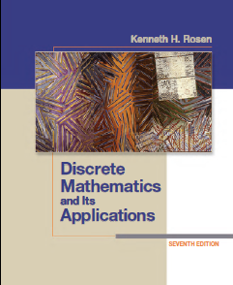
CSE 101: Discrete Mathematics
Slide 06 Graph Tree
Department of Computer Science and Engineering(CSE)
Green University of Bangladesh(GUB)
Notes:
1

Slide 2
Graph
Graphs and graph theory can be used to model:
– Computer networks
– Social networks
– Communications networks
– Information networks
– Software design
– Transportation networks
– Biological networks

Slide 3
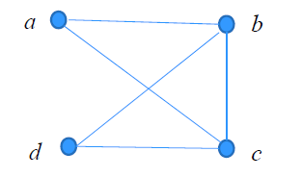
Graph
Definition: A graph G = (V, E) consists of a nonempty set V of vertices (or nodes) and a set E of edges. Each edge has either one or two vertices associated with it, called its endpoints. An edge is said to connect its endpoints.
Example
Notes:
3

Slide 4
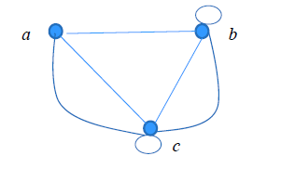
Terminology
In a simple graph each edge connects two different vertices and no two edges connect the same pair of vertices.
Multigraphs may have multiple edges connecting the same two vertices. When m different edges connect the vertices u and v, we say that {u,v} is an edge of multiplicity m.
• An edge that connects a vertex to itself is called a loop.
• A pseudograph may include loops, as well as multiple edges connecting the same pair of vertices.
Notes:
4

Slide 5
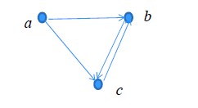
Directed graph
Definition: A directed graph (or digraph) G = (V, E) consists of a
nonempty set V of vertices (or nodes) and a set E of directed edges
(or arcs). Each edge is associated with an ordered pair of vertices.
The directed edge associated with the ordered pair (u,v) is said to
start at u and end at v.
Remark:
– Graphs where the endpoints of an edge are not ordered are said
to be undirected graphs.
Notes:
5

Slide 6
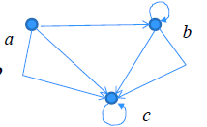
Directed graph
A simple directed graph has no loops and no multiple edges.
A directed multigraph may have multiple directed edges. When there are m directed edges from the vertex u to the vertex v, we say that (u,v) is an edge of multiplicity m.
Example:
• multiplicity of (a,b) is ?
• and the multiplicity of (b,c) is ?
1
2
Notes:
6

Slide 7
Directed graph
Definition: An directed graph G = (V, E) consists of V, a
nonempty set of vertices (or nodes), and E, a set of directed edges
or arcs. Each edge is an ordered pair of vertices. The directed
edge (u,v) is said to start at u and end at v.
Definition: Let (u,v) be an edge in G. Then u is the initial vertex
of this edge and is adjacent to v and v is the terminal (or end)
vertex of this edge and is adjacent from u. The initial and terminal
vertices of a loop are the same.
Notes:
7

Slide 8
Undirected graph
Definition 1. Two vertices u, v in an undirected graph G are called adjacent (or neighbors) in G if there is an edge e between u and v. Such an edge e is called incident with the vertices u and v and e is said to connect u and v.
Definition 2. The set of all neighbors of a vertex v of G = (V, E), denoted by N(v), is called the neighborhood of v. If A is a subset of V, we denote by N(A) the set of all vertices in G that are adjacent to at least one vertex in A.
Definition 3. The degree of a vertex in a undirected graph is the number of edges incident with it, except that a loop at a vertex contributes two to the degree of that vertex. The degree of the vertex v is denoted by deg(v).
Notes:
8

Slide 9
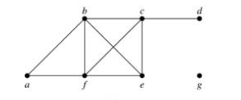
Undirected graph
Example: What are the degrees and neighborhoods of the vertices in the graphs G?
Solution:
G: deg(a) = 2,
deg(b) = deg(c) = deg(f ) = 4,
deg(d ) = 1,
deg(e) = 3,
deg(g) = 0.
N(a) = {b, f }, N(b) = {a, c, e, f }, N(c) = {b, d, e, f },
N(d) = {c}, N(e) = {b, c , f }, N(f) = {a, b, c, e}, N(g) = Ø .
Notes:
9

Slide 10
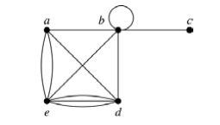
Undirected graph
Example: What are the degrees and neighborhoods of the vertices in the graphs H?
Solution:
H: deg(a) = 4, deg(b) = deg(e) = 6, deg(c) = 1, deg(d) = 5.
N(a) = {b, d, e}, N(b) = {a, b, c, d, e}, N(c) = {b},
N(d) = {a, b, e}, N(e) = {a, b ,d}.
Notes:
10

Slide 11
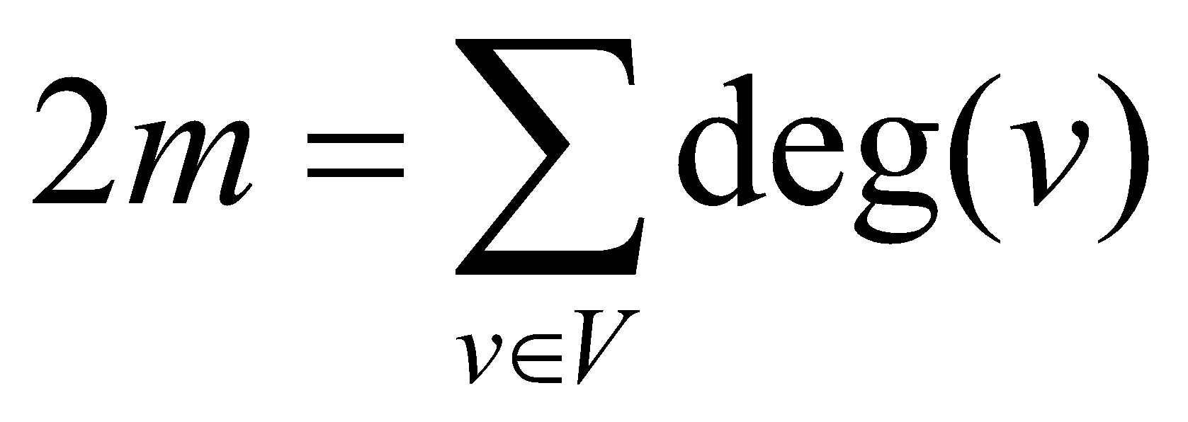
Undirected graph
Theorem 1 : If G = (V,E) is an undirected graph with m edges, then
Proof:
Each edge contributes twice to the degree count of all vertices.
Hence, both the left-hand and right-hand sides of this equation
equal twice the number of edges.
Notes:
11

Slide 12
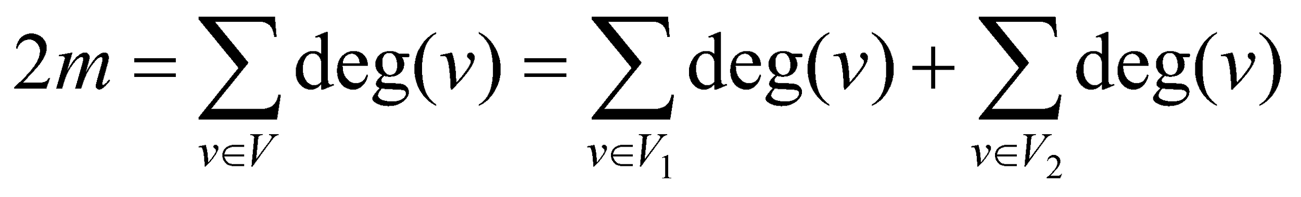
Undirected graph
Theorem 2: An undirected graph has an even number of vertices of odd degree.
Proof: Let V₁ be the vertices of even degree and V₂ be the vertices
of odd degree in an undirected graph G = (V, E) with m edges.
Then
This sum must be even because 2m
is even and the sum of the degrees
of the vertices of even degrees is
also even. Because this is the sum
of the degrees of all vertices of odd
degree in the graph, there must be
an even number of such vertices.
must be
even since
deg(v) is
even for
each v ∈ V₁
Notes:
12

Slide 13
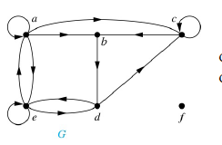
Directed graph
Definition: The in-degree of a vertex v, denoted deg⁻ (v), is the number of edges which terminate at v. The out-degree of v, denoted deg⁺(v), is the number of edges with v as their initial vertex. Note that a loop at a vertex contributes 1 to both the indegree and the out-degree of the vertex
Example: Assume graph G
deg⁻ (a)=2, deg⁻ (b)=2, deg⁻ (c)=3,
deg⁻ (d)=2, deg⁻ (e)=3, deg⁻ (f)=0
Notes:
13

Slide 14
Directed graph
Definition: The in-degree of a vertex v, denoted deg⁻ (v), is the number of edges which terminate at v. The out-degree of v, denoted deg⁺(v), is the number of edges with v as their initial vertex. Note that a loop at a vertex contributes 1 to both the indegree and the out-degree of the vertex
Example: Assume graph G
Deg⁺ (a)=4, deg⁺ (b)=1, deg⁺ (c)=2,
deg⁺ (d)=2, deg⁺ (e)=3, deg⁺ (f)=0
Notes:
14

Slide 15
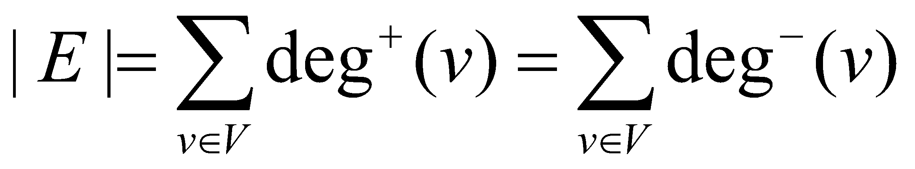
Directed graph
Theorem: Let G = (V, E) be a graph with directed edges. Then:
Proof:
The first sum counts the number of outgoing edges over all vertices
and the second sum counts the number of incoming edges over all
vertices. It follows that both sums equal the number of edges in the
graph.
Notes:
15

Slide 16
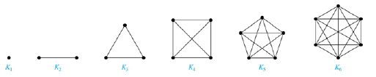
Complete graph
A complete graph on n vertices, denoted by K_{n}, is the simple
graph that contains exactly one edge between each pair of distinct
vertices.
Notes:
16

Slide 17
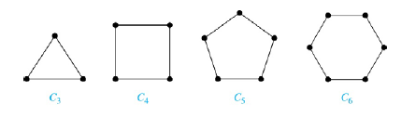
A Cycle
A cycle C_{n} for n ≥ 3 consists of n vertices v₁, v₂ ,⋯ , v_{n}, and edges
{v₁, v₂}, {v₂, v₃} ,⋯ , {v_{n-1}, v_{n}}, {v_{n}, v₁}.
Notes:
17

Slide 18
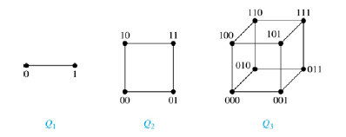
N-dimensional hypercube
An n-dimensional hypercube, or n-cube, Q_{n}, is a graph with 2^{n}
vertices representing all bit strings of length n, where there is an
edge between two vertices that differ in exactly one bit position.
Notes:
18

Slide 19
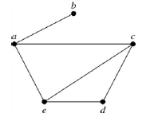
Representation: Adjacency List
Definition: An adjacency list can be used to represent a graph with no multiple edges by specifying the vertices that are adjacent to each vertex of the graph.
Example:
An adjacency list for a simple graph
vertex | Adjacent vertex
a | b, c, e
b | a
c | a, d, e
d | c, e
e | a, c, d
Notes:
19

Slide 20
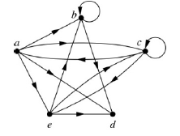
Representation: Adjacency List
Definition: An adjacency list can be used to represent a graph with no multiple edges by specifying the vertices that are adjacent to each vertex of the graph.
Example:
An adjacency list for a directed graph
vertex | Adjacent vertex
a | b, c, d, e
b | b, d
c | a, c, e
d
e | b, c, d
Notes:
20

Slide 21
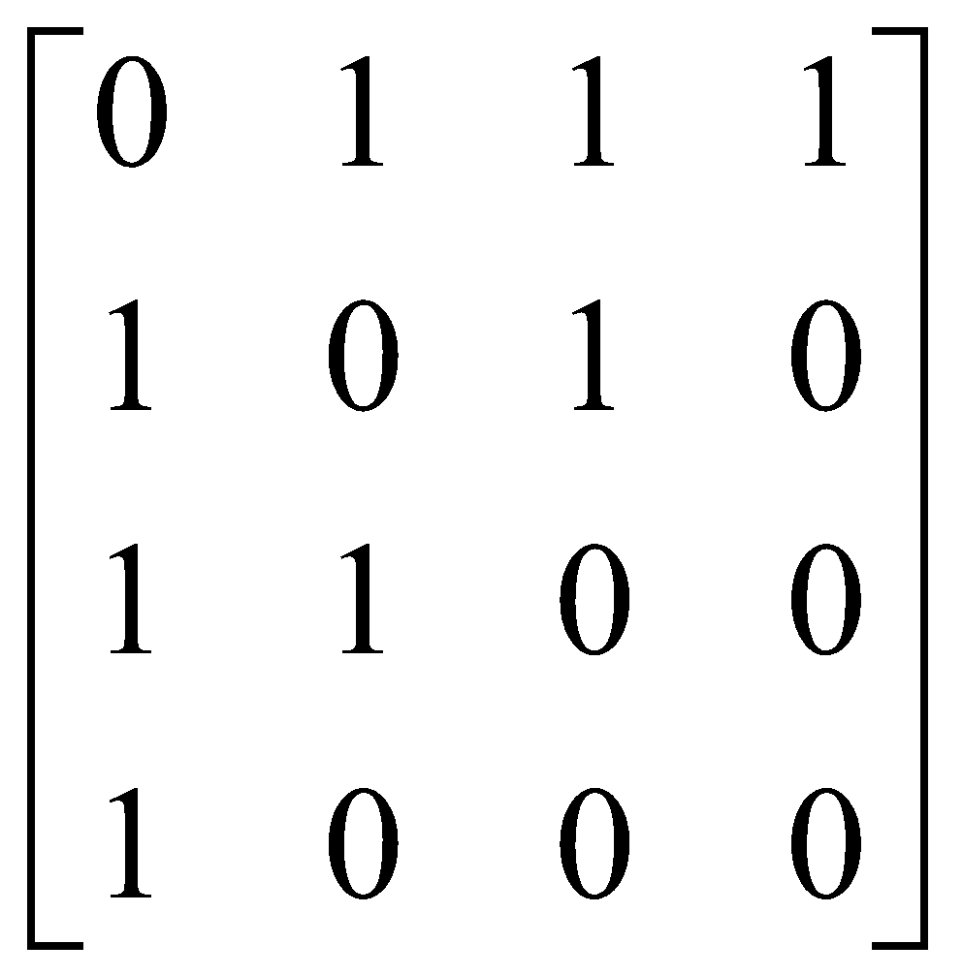

Adjacency Matrix
Definition: Suppose that G = (V, E) is a simple graph where |V| = n. Arbitrarily list the vertices of G as v₁, v₂, … , v_{n}. The adjacency matrix A_{G} of G, with respect to the listing of vertices, is the n × n zero-one matrix with 1 as its (i, j)th entry when v_{i} and v_{j} are adjacent, and 0 as its (i, j)th entry when they are not adjacent.
Example:
Notes:
21

Slide 22
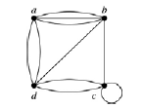
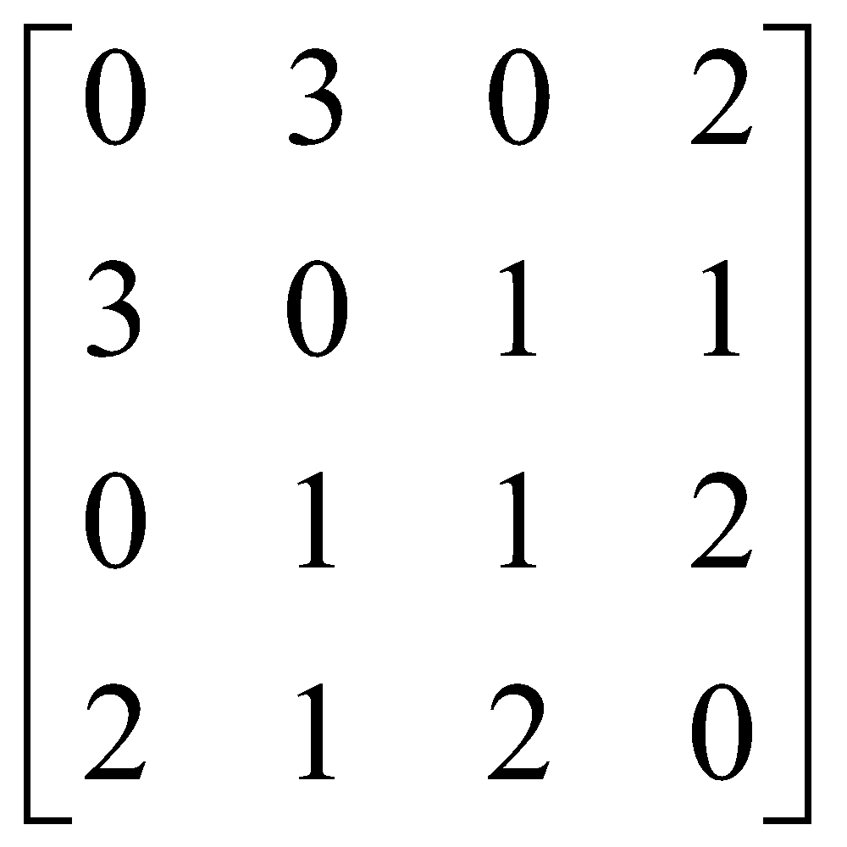
Adjacency Matrix
Adjacency matrices can also be used to represent graphs with loops and multiple edges.
Example: The adjacency matrix of the pseudograph shown here using the ordering of vertices a, b, c, d.
Notes:
22

Slide 23
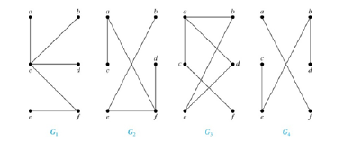
Tree
Definition: A tree is a connected undirected graph with no simple circuits.
Example:
Tree
Tree
Not Tree
Not Tree
Notes:
23

Slide 24
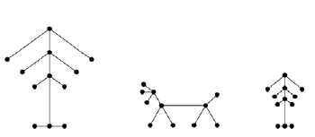
Tree
Definition: A forest is a graph that has no simple circuit, but is not
connected. Each of the connected components in a forest is a tree.
Example:
Notes:
24

Slide 25
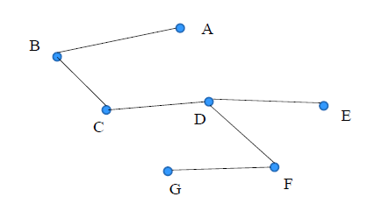
Tree
Theorem: An undirected graph is a tree if and only if there is a
unique simple path between any two of its vertices.
Example:
Notes:
25

Slide 26
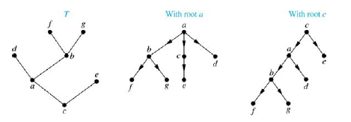
Rooted Tree
Definition: A rooted tree is a tree in which one vertex has been designated as the root and every edge is directed away from the root.
Note: An unrooted tree can be converted into different rooted trees
when one of the vertices is chosen as the root.
Notes:
26

Slide 27
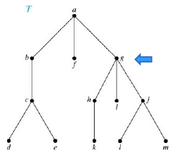
Rooted Tree Terminology
If v is a vertex of a rooted tree other than the root, the parent of v is
the unique vertex u such that there is a directed edge from u to v.
When u is a parent of v, v is called a child of u. Vertices with the
same parent are called siblings.
Parent of g: a
Children of g: h,i,j
Sibling: b, f
Notes:
27

Slide 28
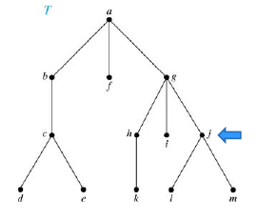
Rooted Tree Terminology
The ancestors of a vertex are the vertices on the path from the root to this vertex, excluding the vertex itself and including the root.
The descendants of a vertex v are those vertices that have v as an ancestor.
Ancestor j: g, a descendant j: l, m
Notes:
28

Slide 29
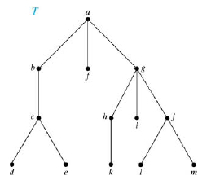
Rooted Tree Terminology
A vertex of a rooted tree with no children is called a leaf. Vertices
that have children are called internal vertices.
Leafs: d, e, k, l, m, f, i
Examples of internal nodes:
b, g, h, c, j, a
Notes:
29

Slide 30
Rooted Tree Terminology
Root is B.
Parent of D:
Children of D:
Siblings of D:
Ancestor D:
Descendant D:
Leafs:
Internal nodes:
Notes:
30

Slide 31
Rooted Tree Terminology
If a is a vertex in a tree, the subtree with a as its root is the
subgraph of the tree consisting of a and its descendants and all
edges incident to these descendants.
Notes:
31

Slide 32
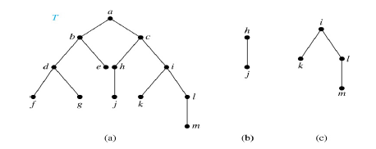
Binary Tree
A binary tree is an ordered rooted where each internal vertex has at most two children. If an internal vertex of a binary tree has two children, the first is called the left child and the second the right child. The tree rooted at the left child of a vertex is called the left subtree of this vertex, and the tree rooted at the right child of a vertex is called the right subtree of this vertex.
Notes:
32

Slide 33
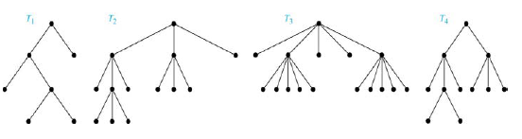
M-ary Tree
Definition: A rooted tree is called an m-ary tree if every internal
vertex has no more than m children. The tree is called a full m-ary
tree if every internal vertex has exactly m children. An m-ary tree
with m = 2 is called a binary tree.
Notes:
33

Slide 34
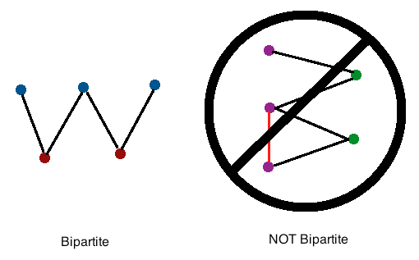
Bipartite Graph
Definition: A simple graph G is bipartite if V can be partitioned
into two disjoint subsets V₁ and V₂ such that every edge connects a
vertex in V₁ and a vertex in V₂. In other words, there are no edges
which connect two vertices in V₁ or in V₂.
Notes:
34

Slide 35
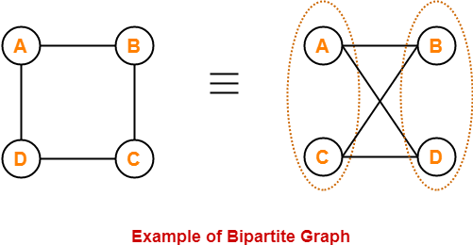
Bipartite Graph
V1 = {A, C}
V2 = {B,D}
Notes:
35

Slide 36

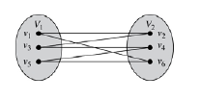
Bipartite Graph
Example: Show that C₆ is bipartite.
Solution: We can partition the vertex set into V₁ = {v₁, v₃, v₅} and V₂ = {v₂, v₄, v₆} so that every edge of C₆ connects a vertex in V₁ and V₂ .
Notes:
36

Slide 37

Bipartite Graph
Example: Show that C₃ is not bipartite.
Solution: If we divide the vertex set of C₃ into two nonempty sets, one of the two must contain two vertices. But in C₃ every vertex is connected to every other vertex. Therefore, the two vertices in the same partition are connected. Hence, C₃ is not bipartite.
Notes:
37

Slide 38
Complete Bipartite Graph
Definition: A complete bipartite graph Km,n is a graph that has its vertex set partitioned into two subsets V₁ of size m and V₂ of size n such that there is an edge from every vertex in V₁ to every vertex in V₂.
Notes:
38

Slide 39
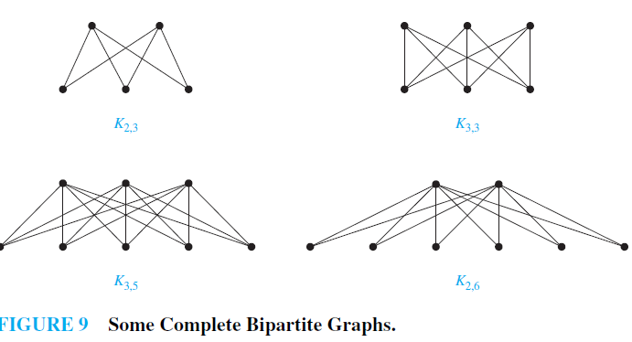
Complete Bipartite Graph
Example: We display four complete bipartite graphs here.
Notes:
39

Slide 40
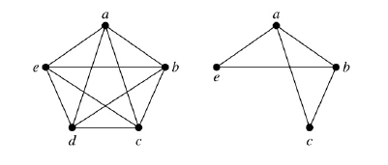
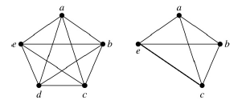
Subgraph
Definition: A subgraph of a graph G = (V,E) is a graph (W,F), where W ⊂ V and F ⊂ E. A subgraph H of G is a proper subgraph of G if H ≠ G.
Example: K₅ and one of its subgraphs.
Example: K₅ and the subgraph induced by W = {a,b,c,e}.
Notes:
40

Slide 41
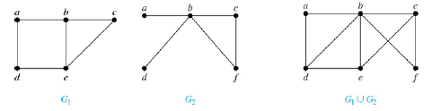
Union of Graph
Definition: The union of two simple graphs G₁ = (V₁, E₁) and G₂ = (V₂, E₂) is the simple graph with vertex set V₁ ⋃ V₂ and edge set E₁ ⋃ E₂. The union of G₁ and G₂ is denoted by G₁ ⋃ G₂.
Example:
Notes:
41

Slide 42
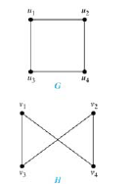
Graph Isomorphism
Definition: The simple graphs G₁ = (V₁, E₁) and G₂ = (V₂, E₂) are isomorphic if there is a one-to-one and onto function f from V₁ to V₂ with the property that a and b are adjacent in G₁ if and only if f(a) and f(b) are adjacent in G₂ , for all a and b in V₁ . Such a function f is called an isomorphism. Two simple graphs that are not isomorphic are called non isomorphic.
one-to-one correspondence between vertices of the two graphs that preserves the adjacency relationship
Are the two graph isomorphic?
u₁ → v₁
u₂ → v₄
u₃ → v₃
u₄ → v₂
f(u₁) = v₁ and f (u₂) = v₄, f (u₁) = v₁ and
f (u₃) = v₃, f (u₂) = v₄ and f (u₄) = v₂,
and f (u₃) = v₃ and f (u₄) = v₂
Notes:
42

Slide 43
Graph Isomorphism
Two graphs G1 and G2 are said to be isomorphic if −
Their number of components (vertices and edges) are same.
Degree sequences of G1 and G2 are same.
Are the two graph isomorphic?
For G1 and G2
Nodes = 4, Edges = 4
Degree sequences = 2,2,2,2.
Notes:
43

Slide 44
Book References
Chapter 10.1(Page 641)
  Problem (1-10) (Page-649)
Chapter 10.2(Page 651)
  Problem (1-58) (Page-665)
Chapter 10.3(Page 668)
  Problem (1-18) (Page-675)
Chapter 11.1(Page 745)
  Problem (1-33) (Page-755)
Notes:
44

Slide 45
Thank You

